Slide 1
Bayesian Inference
Module 7, Lesson 2
Notes:
Welcome to lesson 2 module 7

Slide 2
Hierarchical Linear Models
Shahrzad Jamshidi, PhD
Notes:
In this lesson, we will discuss hierarchical linear models.

Slide 3
Last Time
Bayesian Regression Analysis
Notes:
In the last lesson, we discussed Bayesian regression analysis.

Slide 4
Objectives
Understand and apply standard hierarchical linear models.
Notes:
By the end of this lesson, you will
Understand and apply standard hierarchical linear model.

Slide 5
Hierarchical Regression Models
Hierarchical regression models are multilevel or mixed-effects models that account for data with multiple levels of structure.
Example: Suppose you want to perform a compensation study at a massive university, you will be looking at
employee-level data: years on the job, job satisfaction ratings, etc.
department-level data: number of majors serviced, national demand for the subject, size of the department, etc.
Here, we perform linear regression while respecting this underlying structure in data.
Notes:
Hierarchical regression models are multilevel or mixed-effects models that account for data with multiple levels of structure.
For example, suppose you want to perform a compensation study at a massive university, you will be looking at
employee-level data, things like years on the job, job satisfaction ratings, title, and activities like classes taught and number of grants. In addition to this information, you also need
department-level data, which involves things like the number of majors serviced, national demand for the subject, size of the department, and who the department chair is, because, you know, politics! This is all data that exists at different levels and would be something we’d want to account for in our model.
So what we’ll do is perform linear regression while respecting those levels in the data.

Slide 6
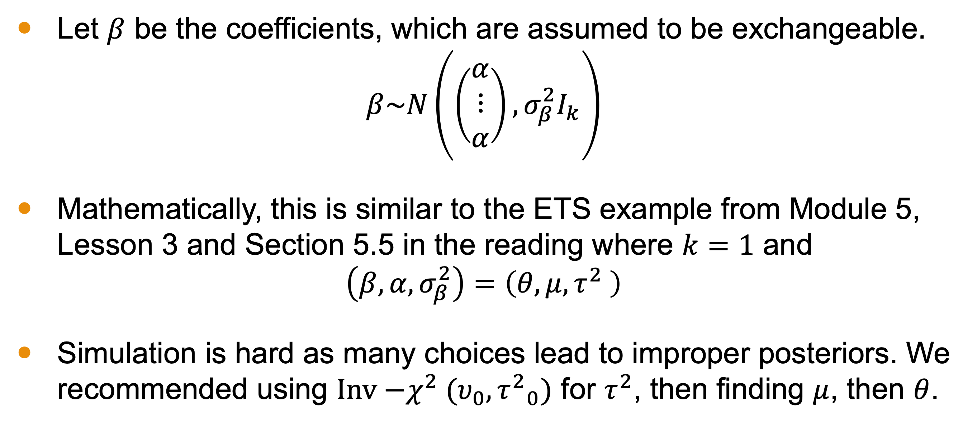
Simple Random Effects Model
Let $β$ be the coefficients, which are assumed to be exchangeable.
$$β\sim N\left(\left(\begin{matrix}α \\ ⋮ \\ α\end{matrix}\right),σ_{β}^{2}I_{k}\right)$$
Mathematically, this is similar to the ETS example from Module 5, Lesson 3 and Section 5.5 in the reading where $k=1$ and
$$\left(β,α,σ_{β}^{2}\right)=\left(θ,μ,τ^{2} \right)$$
Simulation is hard as many choices lead to improper posteriors. We recommended using $Inv{−χ}^{2}(υ_{0},{τ^{2}}_{0})$ for $τ^{2}$, then finding $μ$, then $θ$.
Notes:
In the simplest form of the random-effects, all of the coefficients are exchangeable, and their population distribution can be expressed as
β ∼ N(1α,σβ2I),
where α and σβ are unknown scalar parameters.
This model is equivalent to the hierarchical model we applied to the educational testing example of Section 5.5, using (β,α,σβ) in place of (θ,μ,τ).
It can be reasonable to start with a prior density that is uniform on α, σβ , as we used in the educational testing example. As discussed in the reading for module 5, we cannot assign a uniform prior distribution because this leads to an improper posterior distribution. Another relatively noninformative prior distribution is the scaled inverse-χ2 with the degrees of freedom set to a low number such as 2.
This is distinct however from our hierarchical example where there was a natural grouping of the data. Here, the pieces are all one group, like the ETS example from module 5.

Slide 7
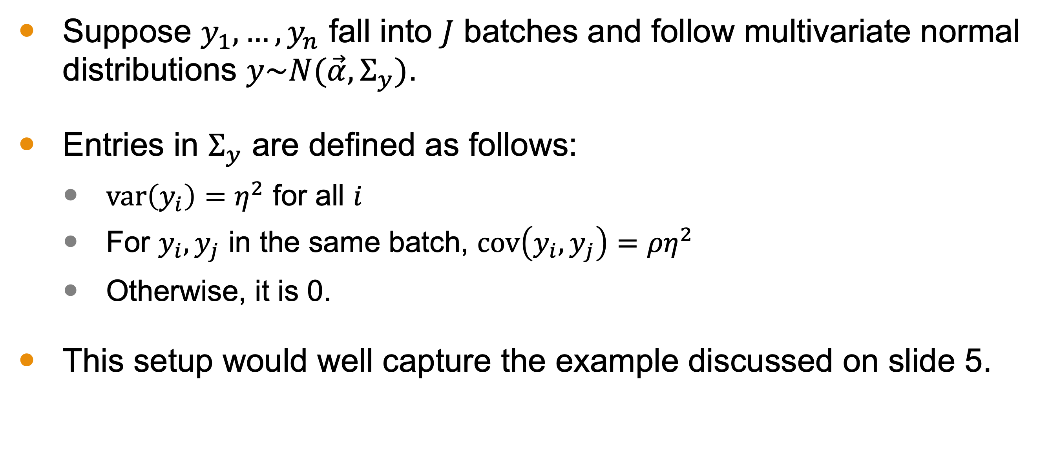
Intraclass Correlation
Suppose $y_{1},…,y_{n}$ fall into $J$ batches and follow multivariate normal distributions $y\sim N(\vec{α},Σ_{y})$.
Entries in $Σ_{y}$ are defined as follows:
$var\left(y_{i}\right)=η^{2}$ for all $i$
For $y_{i},y_{j}$ in the same batch, $cov\left(y_{i},y_{j}\right)={ρη}^{2}$
Otherwise, it is 0.
This setup would well capture the example discussed on slide 5.
Notes:
There is a straightforward connection between the random-effects model just described and a within-group correlation, like the compensation analysis example.
Suppose data y1, . . . , yn fall into J batches and have a multivariate normal distribution: y∼N(α1,Σy) ,where… read slide

Slide 8
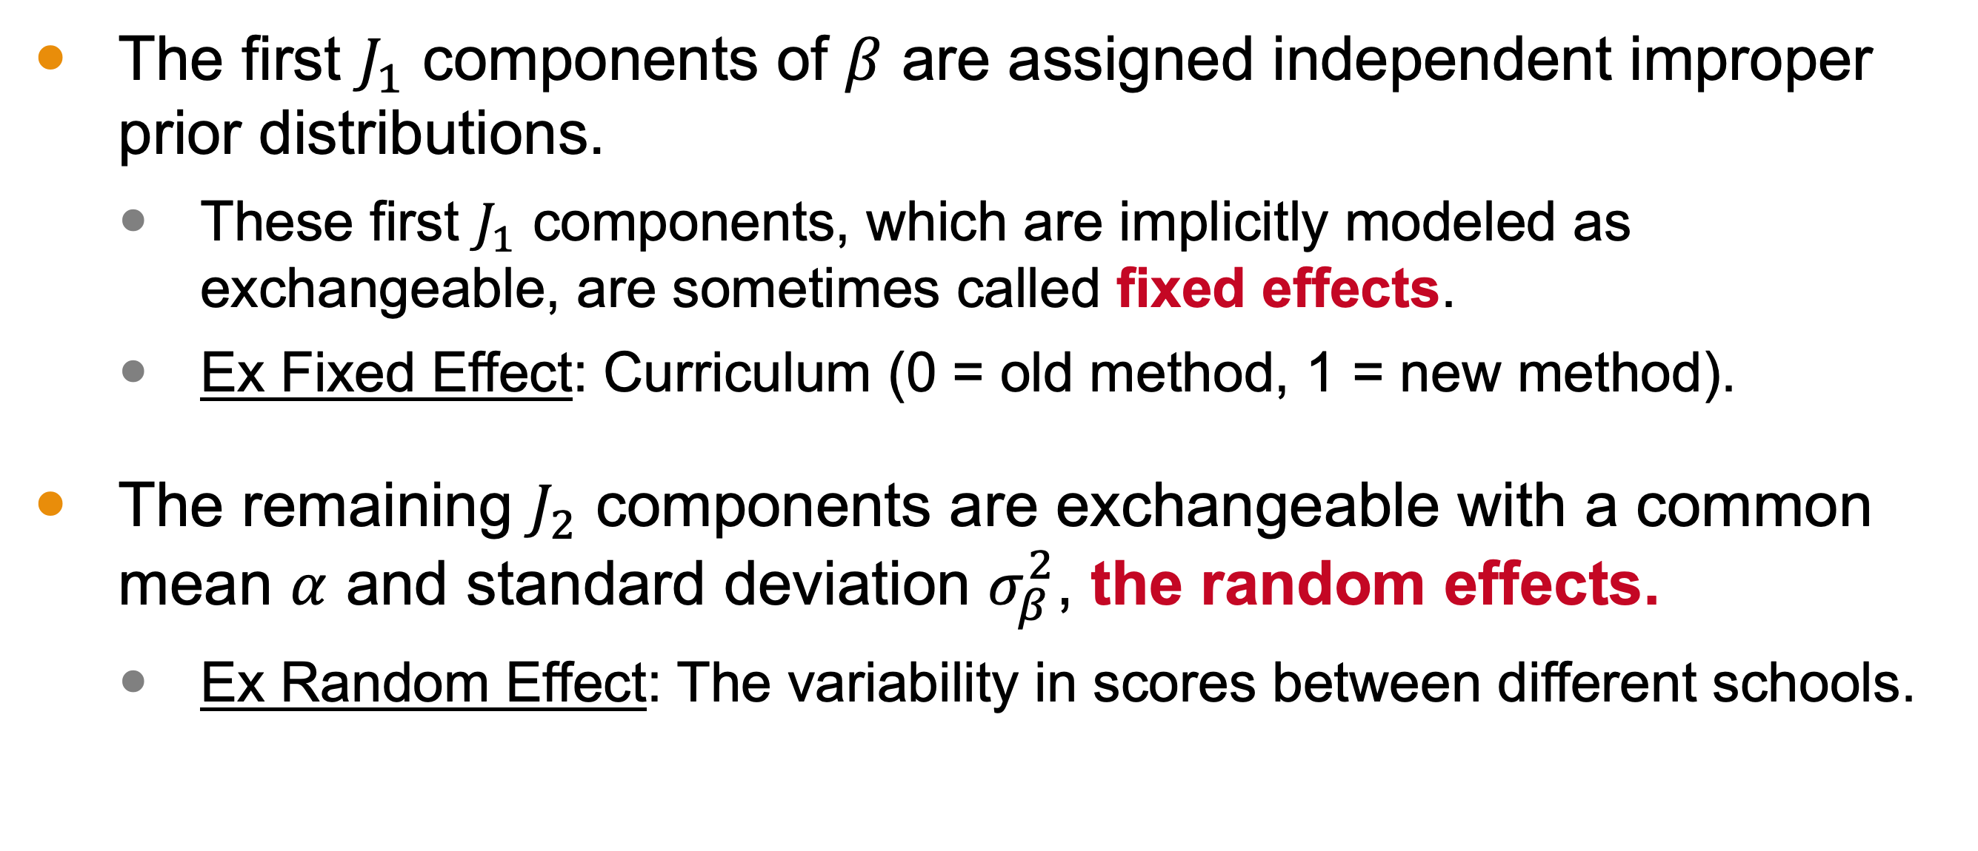
Mixed Effects Model
The first $J_{1}$ components of $β$ are assigned independent improper prior distributions.
These first $J_{1}$ components, which are implicitly modeled as exchangeable, are sometimes called fixed effects.
Ex Fixed Effect: Curriculum (0 = old method, 1 = new method).
The remaining $J_{2}$ components are exchangeable with a common mean $α$ and standard deviation $σ_{β}^{2}$, the random effects.
Ex Random Effect: The variability in scores between different schools.
Notes:
An important variation on the random-effects model is the ‘mixed-effects model,’ in which the first J1 components of β are assigned independent improper prior distributions,
and the remaining J2 = J − J1 components are exchangeable with common mean α and standard deviation σβ, like the simple random effects model.

Slide 9
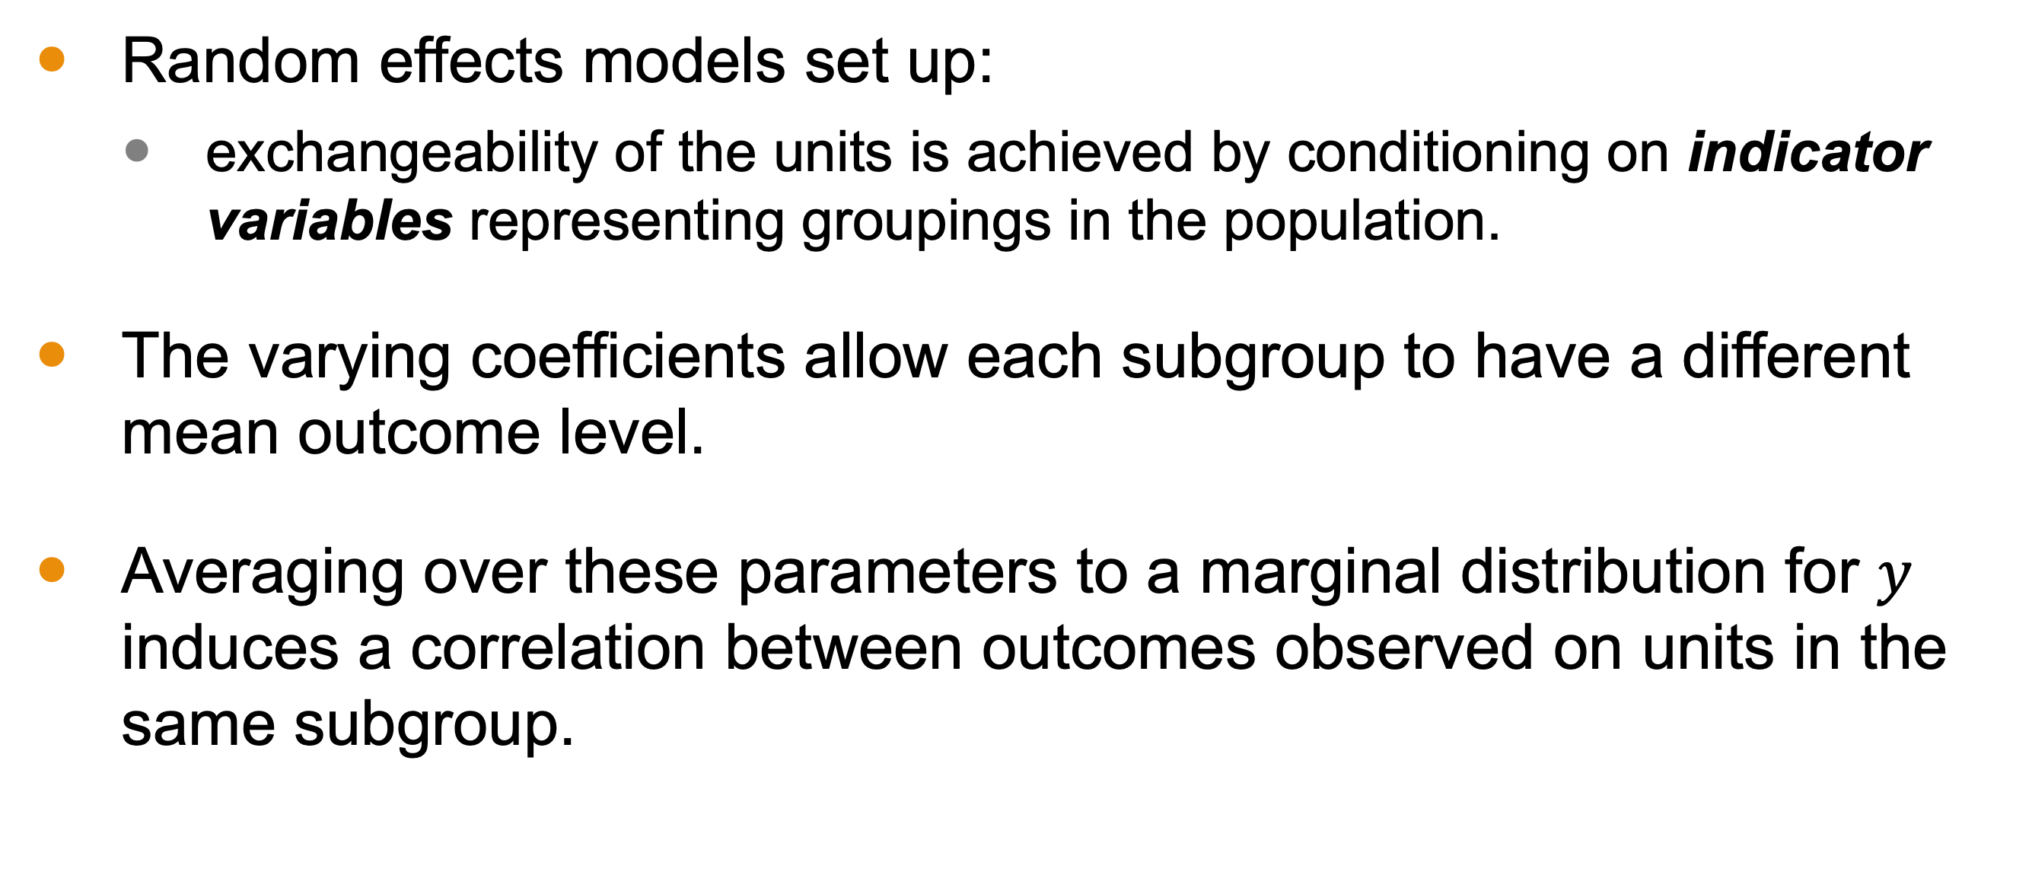
Exchangeability
Random effects models set up:
exchangeability of the units is achieved by conditioning on indicator variables representing groupings in the population.
The varying coefficients allow each subgroup to have a different mean outcome level.
Averaging over these parameters to a marginal distribution for $y$ induces a correlation between outcomes observed on units in the same subgroup.
Notes:
The essential feature of Random effects models is that exchangeability of the units of analysis is achieved by conditioning on indicator variables that represent groupings in the population. The varying coefficients allow each subgroup to have a different mean outcome level, and averaging over these parameters to a marginal distribution for y induces a correlation between outcomes observed on units in the same subgroup (just as in the simple intraclass correlation model described above).

Slide 10
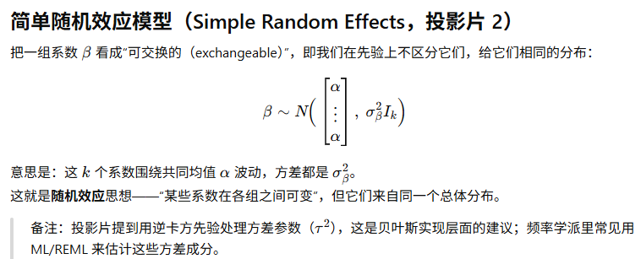
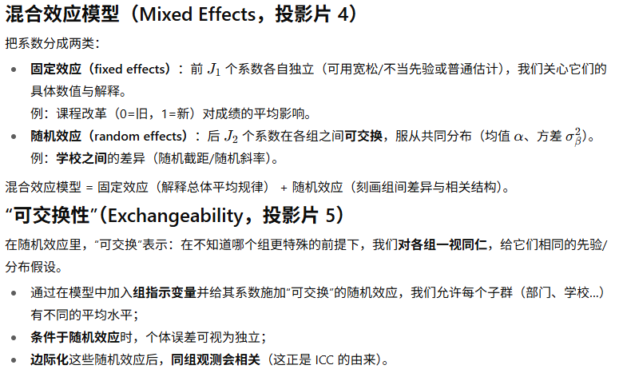
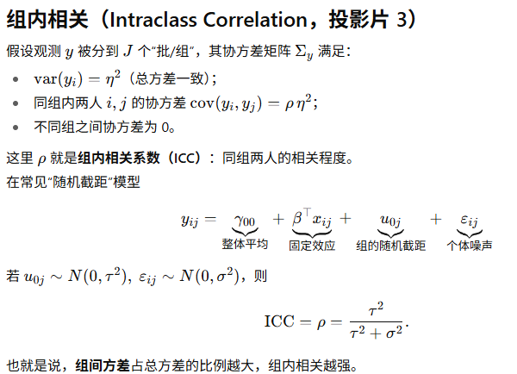
Summary
Notes:
The essential feature of Random effects models is that exchangeability of the units of analysis is achieved by conditioning on indicator variables that represent groupings in the population. The varying coefficients allow each subgroup to have a different mean outcome level, and averaging over these parameters to a marginal distribution for y induces a correlation between outcomes observed on units in the same subgroup (just as in the simple intraclass correlation model described above).

Slide 11
Example: Forecasting Presidential Elections
Technique:
Begin by fitting a nonhierarchical linear regression with a noninformative prior distribution.
Find that the simple model does not provide an adequate fit.
Expand the model hierarchically, including varying coefficients to model variation at a second level in the data.
Example:
A hierarchical linear model used to predict the 1992 election, built from past elections from 1948 until 1988.
11 presidential elections.
Notes:
We are talking about these ideas abstractly, so let’s illustrate hierarchical linear modeling with a realistic example
We will do the following within this example:
Begin by fitting a nonhierarchical linear regression with a noninformative prior distribution.
Find that the simple model does not provide an adequate fit.
Expand the model hierarchically, including varying coefficients to model variation at a second level in the data. This is a method you can do in a variety of situations that are distinct from the example.
The details of the example are the following:
A hierarchical linear model used to predict the 1992 election, built from past elections from 1948 until 1988.
11 presidential elections.

Slide 12
Unit Analysis and Outcome Variable
The outcome variable of the regression is the Democratic party candidate’s share of the two-party vote for president in that state and year.
To avoid tangential issues:
Discard the District of Columbia
Exclude states with third-party victories from the model.
This leaves us with 511 units from the 11 elections considered.
Notes:
Discard the District of Columbia (where Democrats have received over 80% in every presidential election).

Slide 13
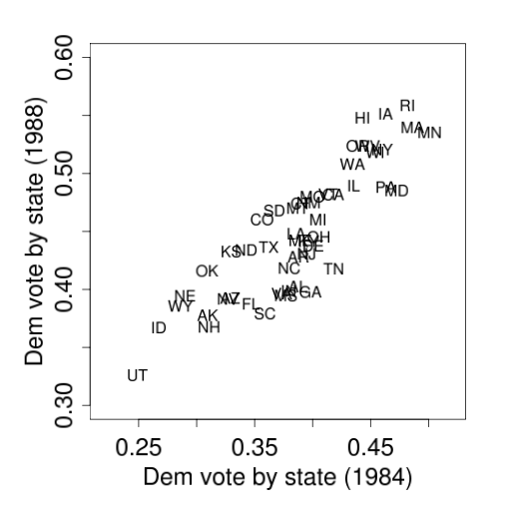
Preliminary Geographical Analysis
The graph suggests the vote is predictable from one election to the next.
Points fall close to a straight line.
This indicating that a linear model is sufficient for prediction.
Taken from BDA3

Slide 14
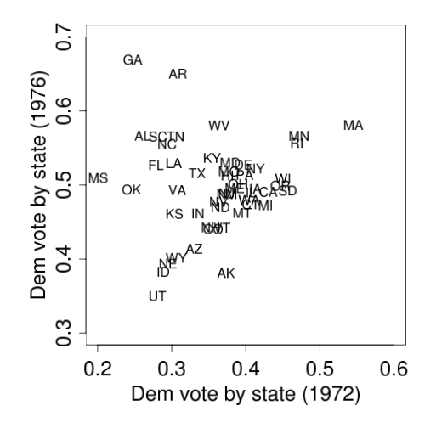
Preliminary Geographical Analysis
The relation is not as close to linear as the previous one.
However, there are observable patterns:
Both GA and SC had important ties to Jimmy Carter.
Including additional predictors, such as candidates’ home regions, may improve the the model.
Taken from BDA3

Slide 15
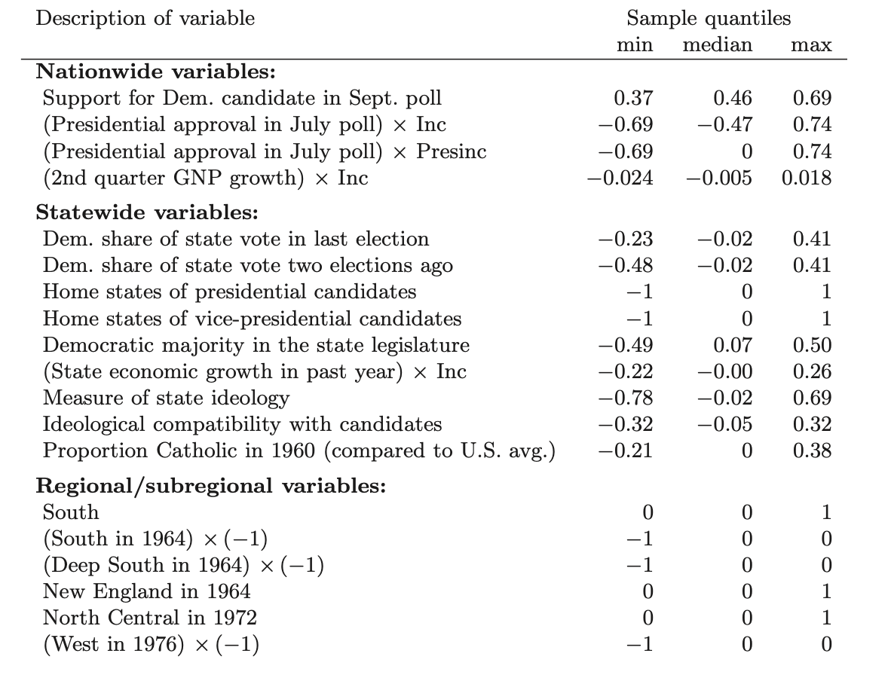
A Preliminary Linear Model
Political trends can fall on multiple levels.
Nationwide: popularity, incumbent popularity, economy.
Regional: candidate’s region.
State: Democratic historical performance in state, state’s economy, state’s politics, home state indicator.
Taken from BDA3
Notes:
Variables used for forecasting U.S. presidential elections. Sample minima, medians, and maxima come from the 511 data points. All variables are signed so that an increase in a variable would be expected to increase the Democratic share of the vote in a state. ‘Inc’ is defined to be +1 or −1 depending on whether the incumbent President is a Democrat or a Republican. ‘Presinc’ equals Inc if the incumbent President is running for reelection and 0 otherwise. ‘Dem. share of state vote’ in last election and two elections ago are coded as deviations from the corresponding national votes, to allow for a better approximation to prior independence among the regression coefficients. ‘Proportion Catholic’ is the deviation from the average proportion in 1960, the only year in which a Catholic ran for President. See Gelman and King (1993) and Boscardin and Gelman (1996) for details on the other variables, including a discussion of the regional/subregional variables. When fitting the hierarchical model, we also included indicators for years and regions within years.

Slide 16
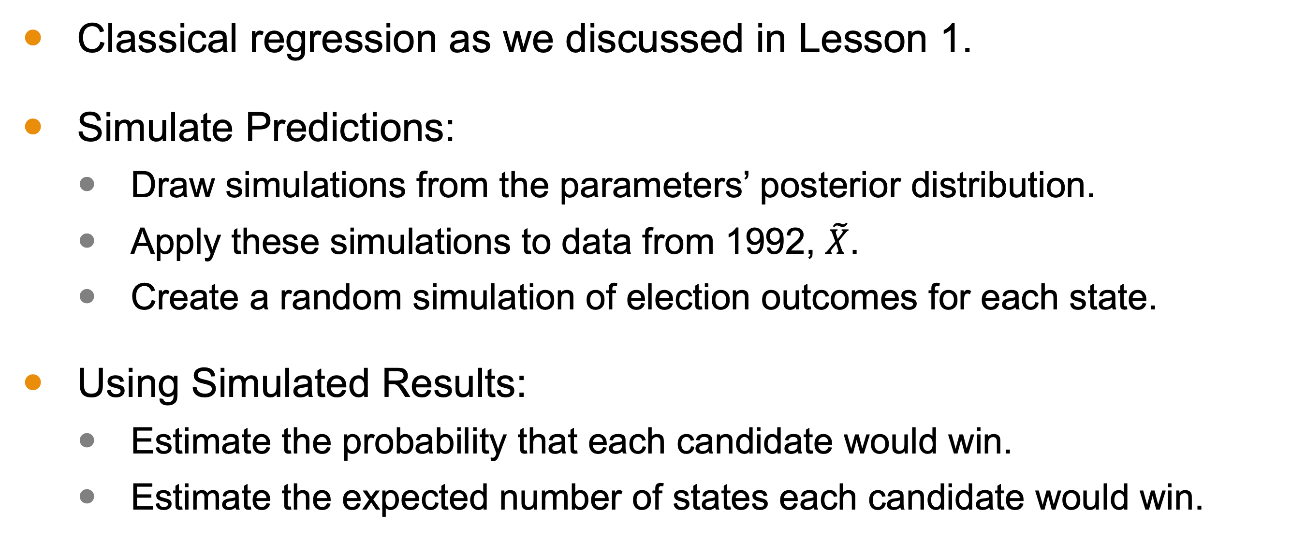
First Analysis
Classical regression as we discussed in Lesson 1.
Simulate Predictions:
Draw simulations from the parameters’ posterior distribution.
Apply these simulations to data from 1992, $\tilde{X}$.
Create a random simulation of election outcomes for each state.
Using Simulated Results:
Estimate the probability that each candidate would win.
Estimate the expected number of states each candidate would win.

Slide 17
Limitations of Initial Model
Ignores the year-by-year structure of the data.
Treats the data as flat instead of 11 sets of 50 observations.
Misses that partisan support across states is not independent.
For example, a higher-than-expected vote share for the Democratic candidate in Massachusetts in a particular year would likely correlate with a better-than-expected performance in Utah in the same year.
The assumption of exchangeability among the 511 observations does not make sense, even after controlling for explanatory variables.

Slide 18
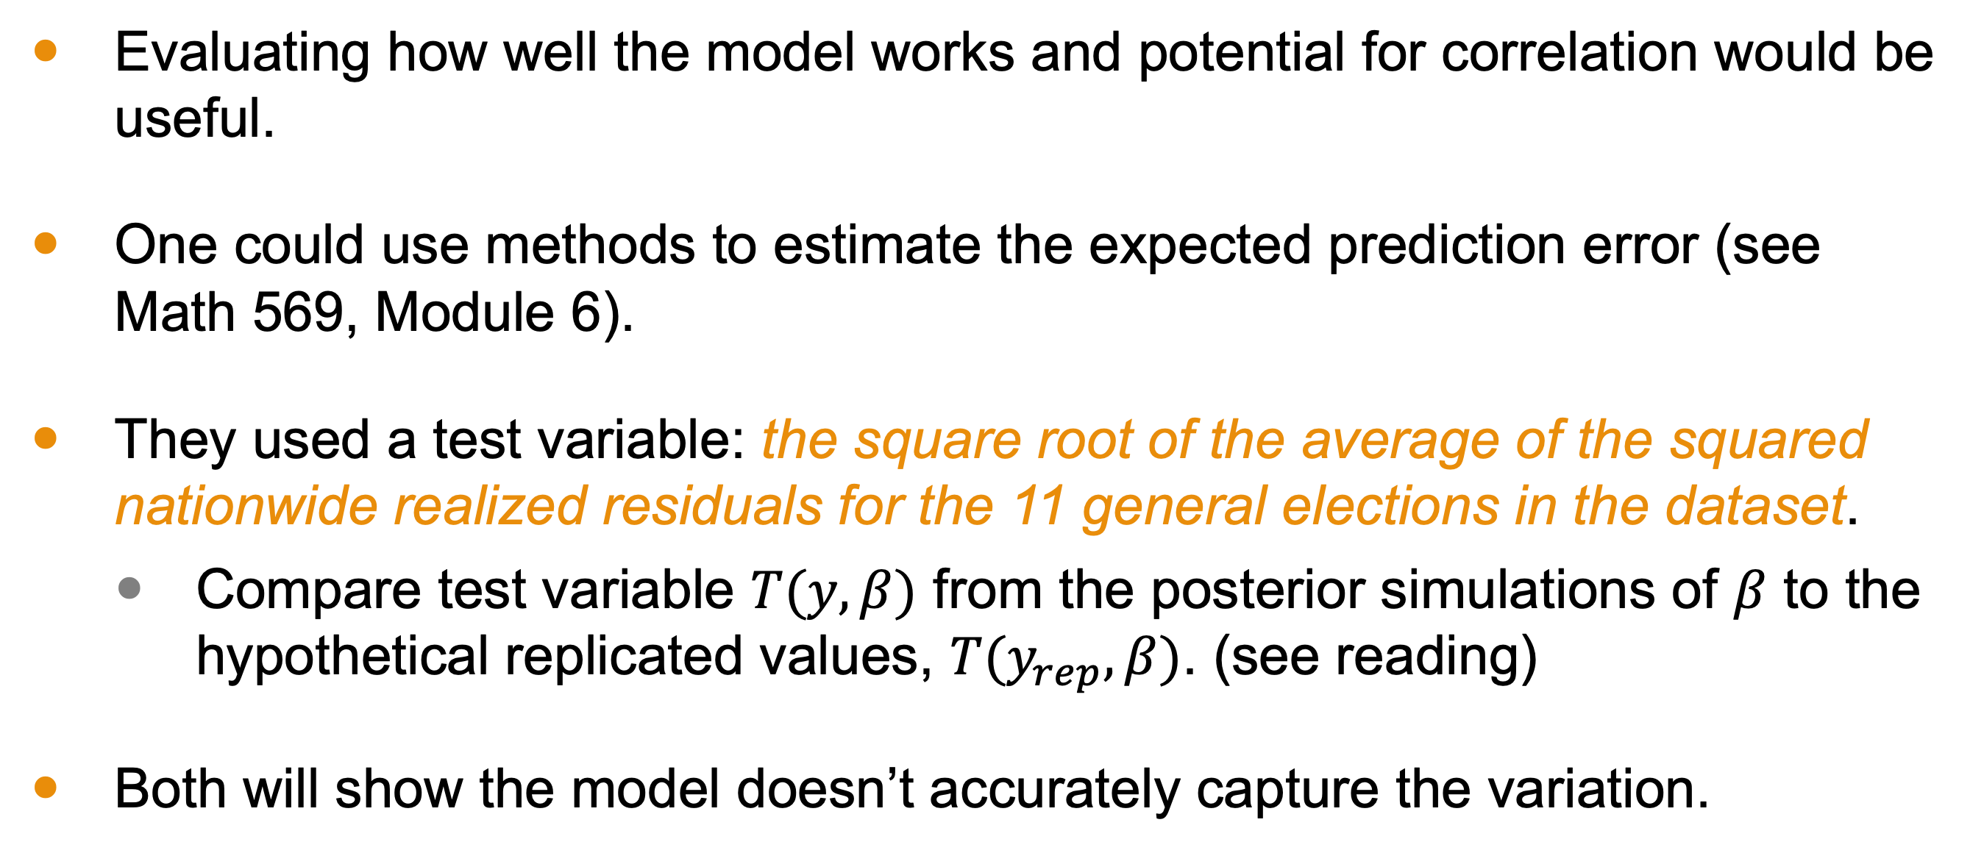
Test Model
Evaluating how well the model works and potential for correlation would be useful.
One could use methods to estimate the expected prediction error (see Math 569, Module 6).
They used a test variable: the square root of the average of the squared nationwide realized residuals for the 11 general elections in the dataset.
Compare test variable $T(y,β)$ from the posterior simulations of $β$ to the hypothetical replicated values, $T(y_{rep},β)$. (see reading)
Both will show the model doesn’t accurately capture the variation.
Notes:
• Assess significance of possible model failures using the model-checking approach from Chapter 6.
• Test Variable for Model Precision:
• Create a test variable reflecting the average precision of the model in predicting the national result.
• This test variable is the square root of the average of the squared nationwide realized residuals for the 11 general elections in the dataset.
• Each nationwide realized residual is the average of (y_i - X_i \beta) for the roughly 50 observations in that election year.
• Model-Checking Process:
• Compare values of the test variable T(y, \beta) from the posterior simulations of \beta to the hypothetical replicated values under the model, T(y_{rep}, \beta).
• Results and Implications:
• Figure 15.2 shows that the observed variation in national election results is larger than expected from the model.
• The practical consequence is that the model’s forecasts of national election results are falsely precise due to failure to account for year-by-year correlation.

Slide 19
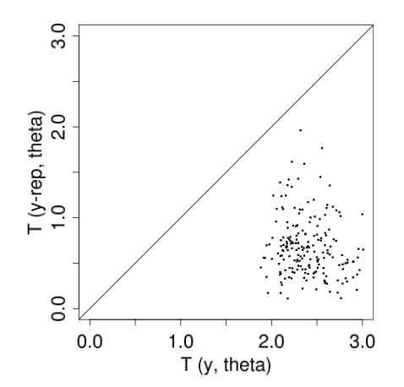
Linear Model versus Hierarchical Model
Replications look more precise
Notes:
Replicated data with the linear model appears to have less errors—remember this test variable is a measure based on the residuals.
But historical data suggests larger errors. This suggests that our linear more might be too exhuberant about our predictions
By making them look more precise. Now let’s look at our hierarchical model. The replicated data
Has measured error rate on par with the linear model, but the historical data
Is also on that same level. This suggests that
the model is better capturing the dynamics underlying the data.

Slide 20
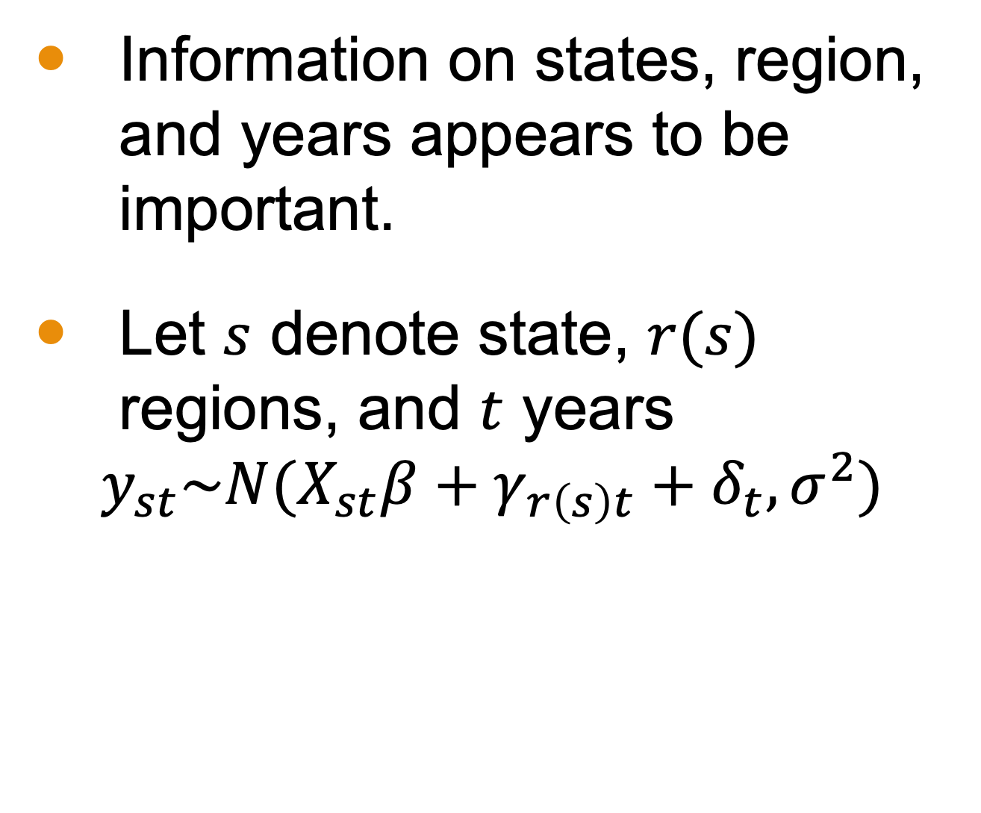
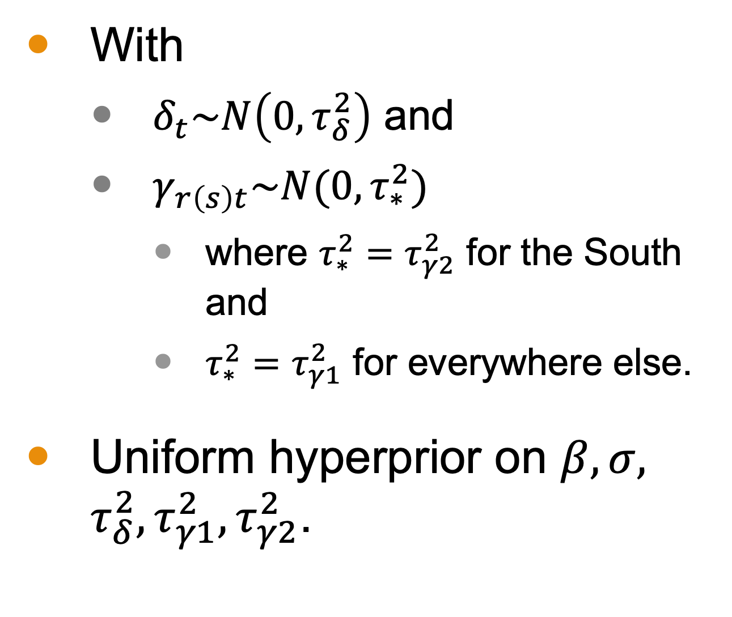
Defining the Hierarchical Model
Information on states, region, and years appears to be important.
Let $s$ denote state, $r(s)$ regions, and $t$ years
$$y_{st}\sim N(X_{st}β+γ_{r\left(s\right)t}+δ_{t},σ^{2})$$
With
$δ_{t}\sim N\left(0,τ_{δ}^{2}\right)$ and
$γ_{r\left(s\right)t}\sim N(0,τ_{∗}^{2})$
where $τ_{∗}^{2}=τ_{γ2}^{2}$ for the South and
$τ_{∗}^{2}=τ_{γ1}^{2}$ for everywhere else.
Uniform hyperprior on $β,σ,$ $τ_{δ}^{2},τ_{γ1}^{2},τ_{γ2}^{2}$.
Notes:
If we wished to maintain the model type as ordinary linear regression, we could add 11 indicator variables to capture election year.

Slide 21
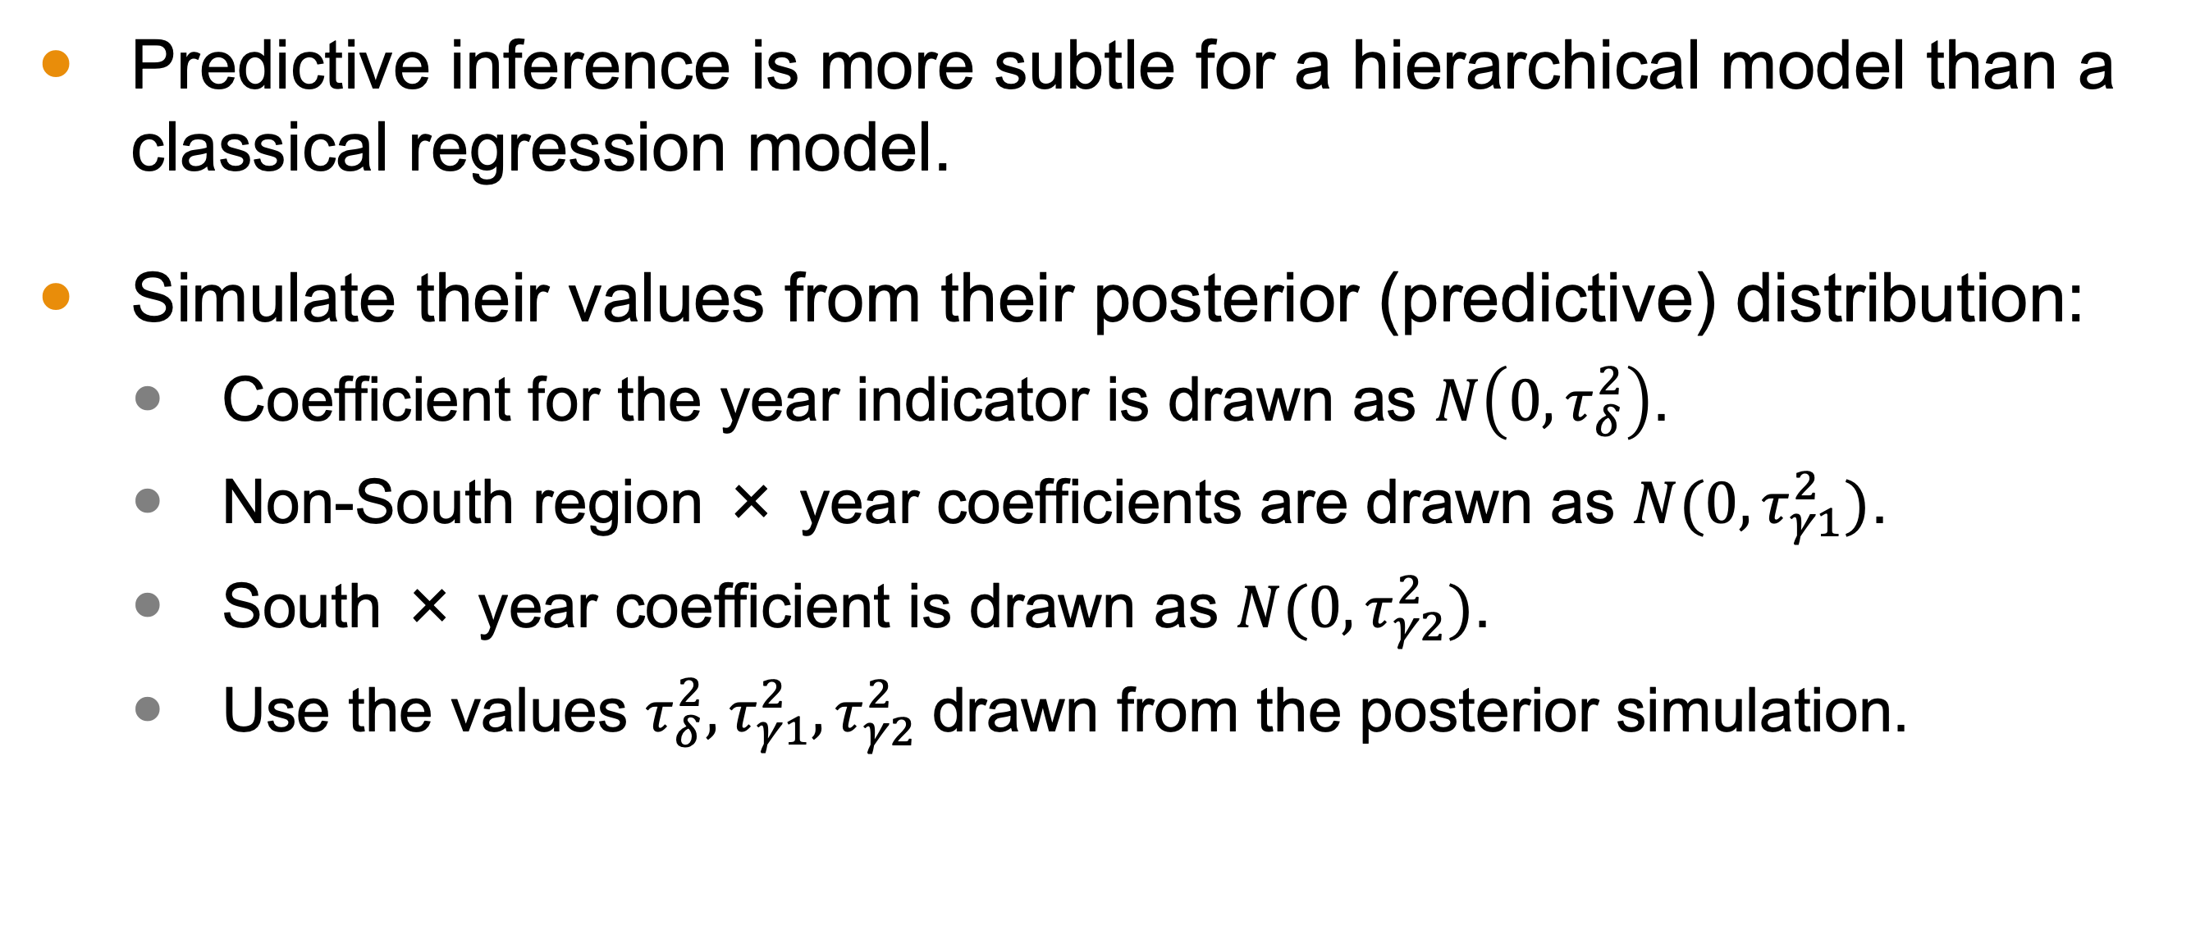
Forecasting with the Hierarchical Model
Predictive inference is more subtle for a hierarchical model than a classical regression model.
Simulate their values from their posterior (predictive) distribution:
Coefficient for the year indicator is drawn as $N\left(0,τ_{δ}^{2}\right)$.
Non-South region × year coefficients are drawn as $N(0,τ_{γ1}^{2})$.
South × year coefficient is drawn as $N(0,τ_{γ2}^{2})$.
Use the values $τ_{δ}^{2},τ_{γ1}^{2},τ_{γ2}^{2}$drawn from the posterior simulation.
Notes:
Predictive inference is more subtle for a hierarchical model than a classical regression model, because of the possibility that new parameters (varying coefficients) β must be estimated for the predictive data.

Slide 22
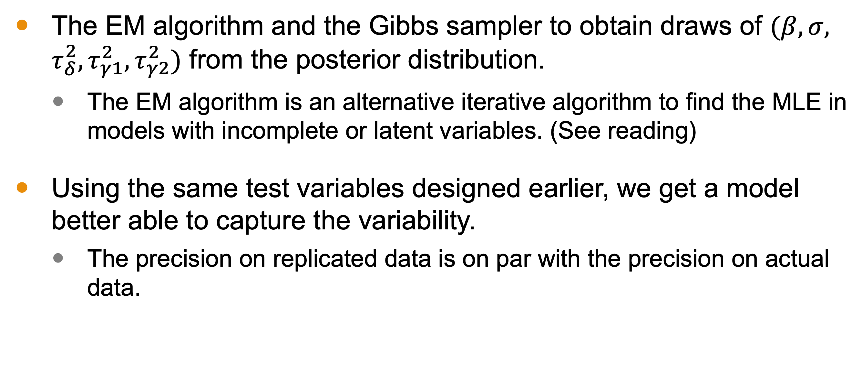
Fitting the Model & Results
The EM algorithm and the Gibbs sampler to obtain draws of $(β,σ,$ $τ_{δ}^{2},τ_{γ1}^{2},τ_{γ2}^{2})$ from the posterior distribution.
The EM algorithm is an alternative iterative algorithm to find the MLE in models with incomplete or latent variables. (See reading)
Using the same test variables designed earlier, we get a model better able to capture the variability.
The precision on replicated data is on par with the precision on actual data.
Notes:
The Expectation-Maximization (EM) algorithm is an iterative method used to find maximum likelihood estimates of parameters in statistical models with incomplete or latent variables. It alternates between two steps: the Expectation step (E-step), which calculates the expected value of the log-likelihood function given the current parameter estimates and observed data, and the Maximization step (M-step), which updates the parameters to maximize this expected log-likelihood. The process repeats until convergence, yielding parameter estimates that best explain the observed data.

Slide 23
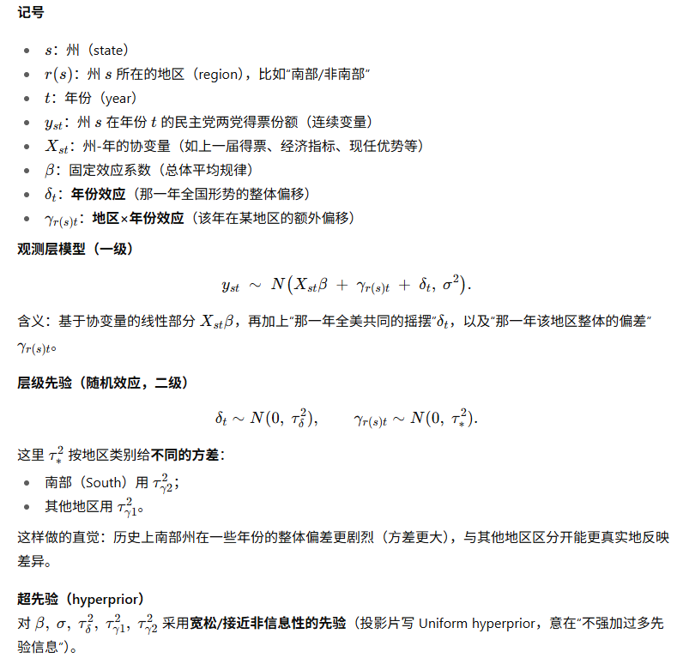
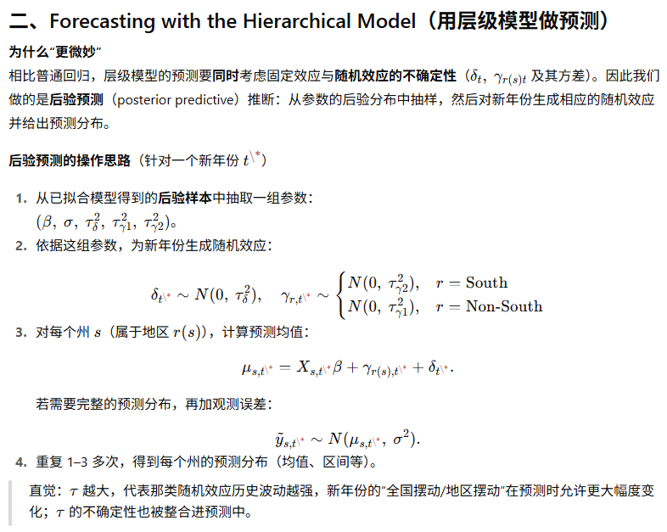
Summary

Slide 24
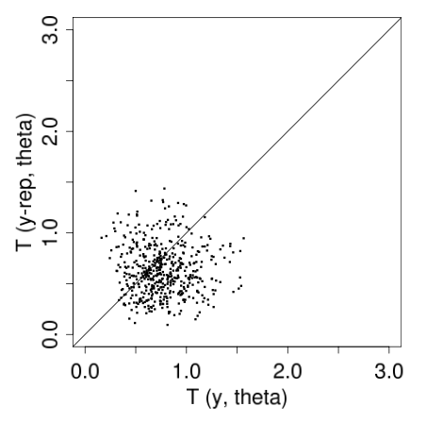
Linear Model versus Hierarchical Model
Replications similar to real data
Replications look more precise
Notes:
Replicated data with the linear model appears to have less errors—remember this test variable is a measure based on the residuals.
But historical data suggests larger errors. This suggests that our linear more might be too exhuberant about our predictions
By making them look more precise. Now let’s look at our hierarchical model. The replicated data
Has measured error rate on par with the linear model, but the historical data
Is also on that same level. This suggests that
the model is better capturing the dynamics underlying the data.

Slide 25
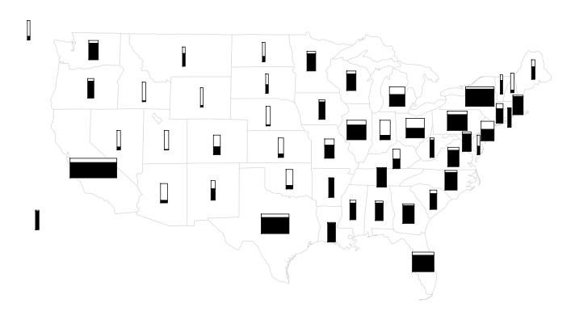
Results
When applied to data from 1992, the model yields state-by-state predictions, with a forecasted 85% probability that the Democrats would win the national electoral vote total. The forecasts for individual states have predictive standard errors between 5% and 6%.
Taken from BDA3

Slide 26
Generalization of Hierarchical Linear Models
Models can be extended to more levels of parameters, representing additional structure.
Examples:
Educational achievement study where class-level effects depend on school district or state features.
Extending the election forecasting model to account for year-by-year errors using trends over time.
Notes:
First Example:
Level 1 (Individual Level): Student-level data, such as individual test scores.
Level 2 (Class Level): Class-level effects, such as teacher quality or classroom environment.
Level 3 (School/District Level): School district or state-level effects, such as funding levels, policies, or socioeconomic factors.
Second Example:
• Level 1 (State Level): State-level data for each election year.
• Level 2 (Year Level): National trends and year-specific effects.

Slide 27
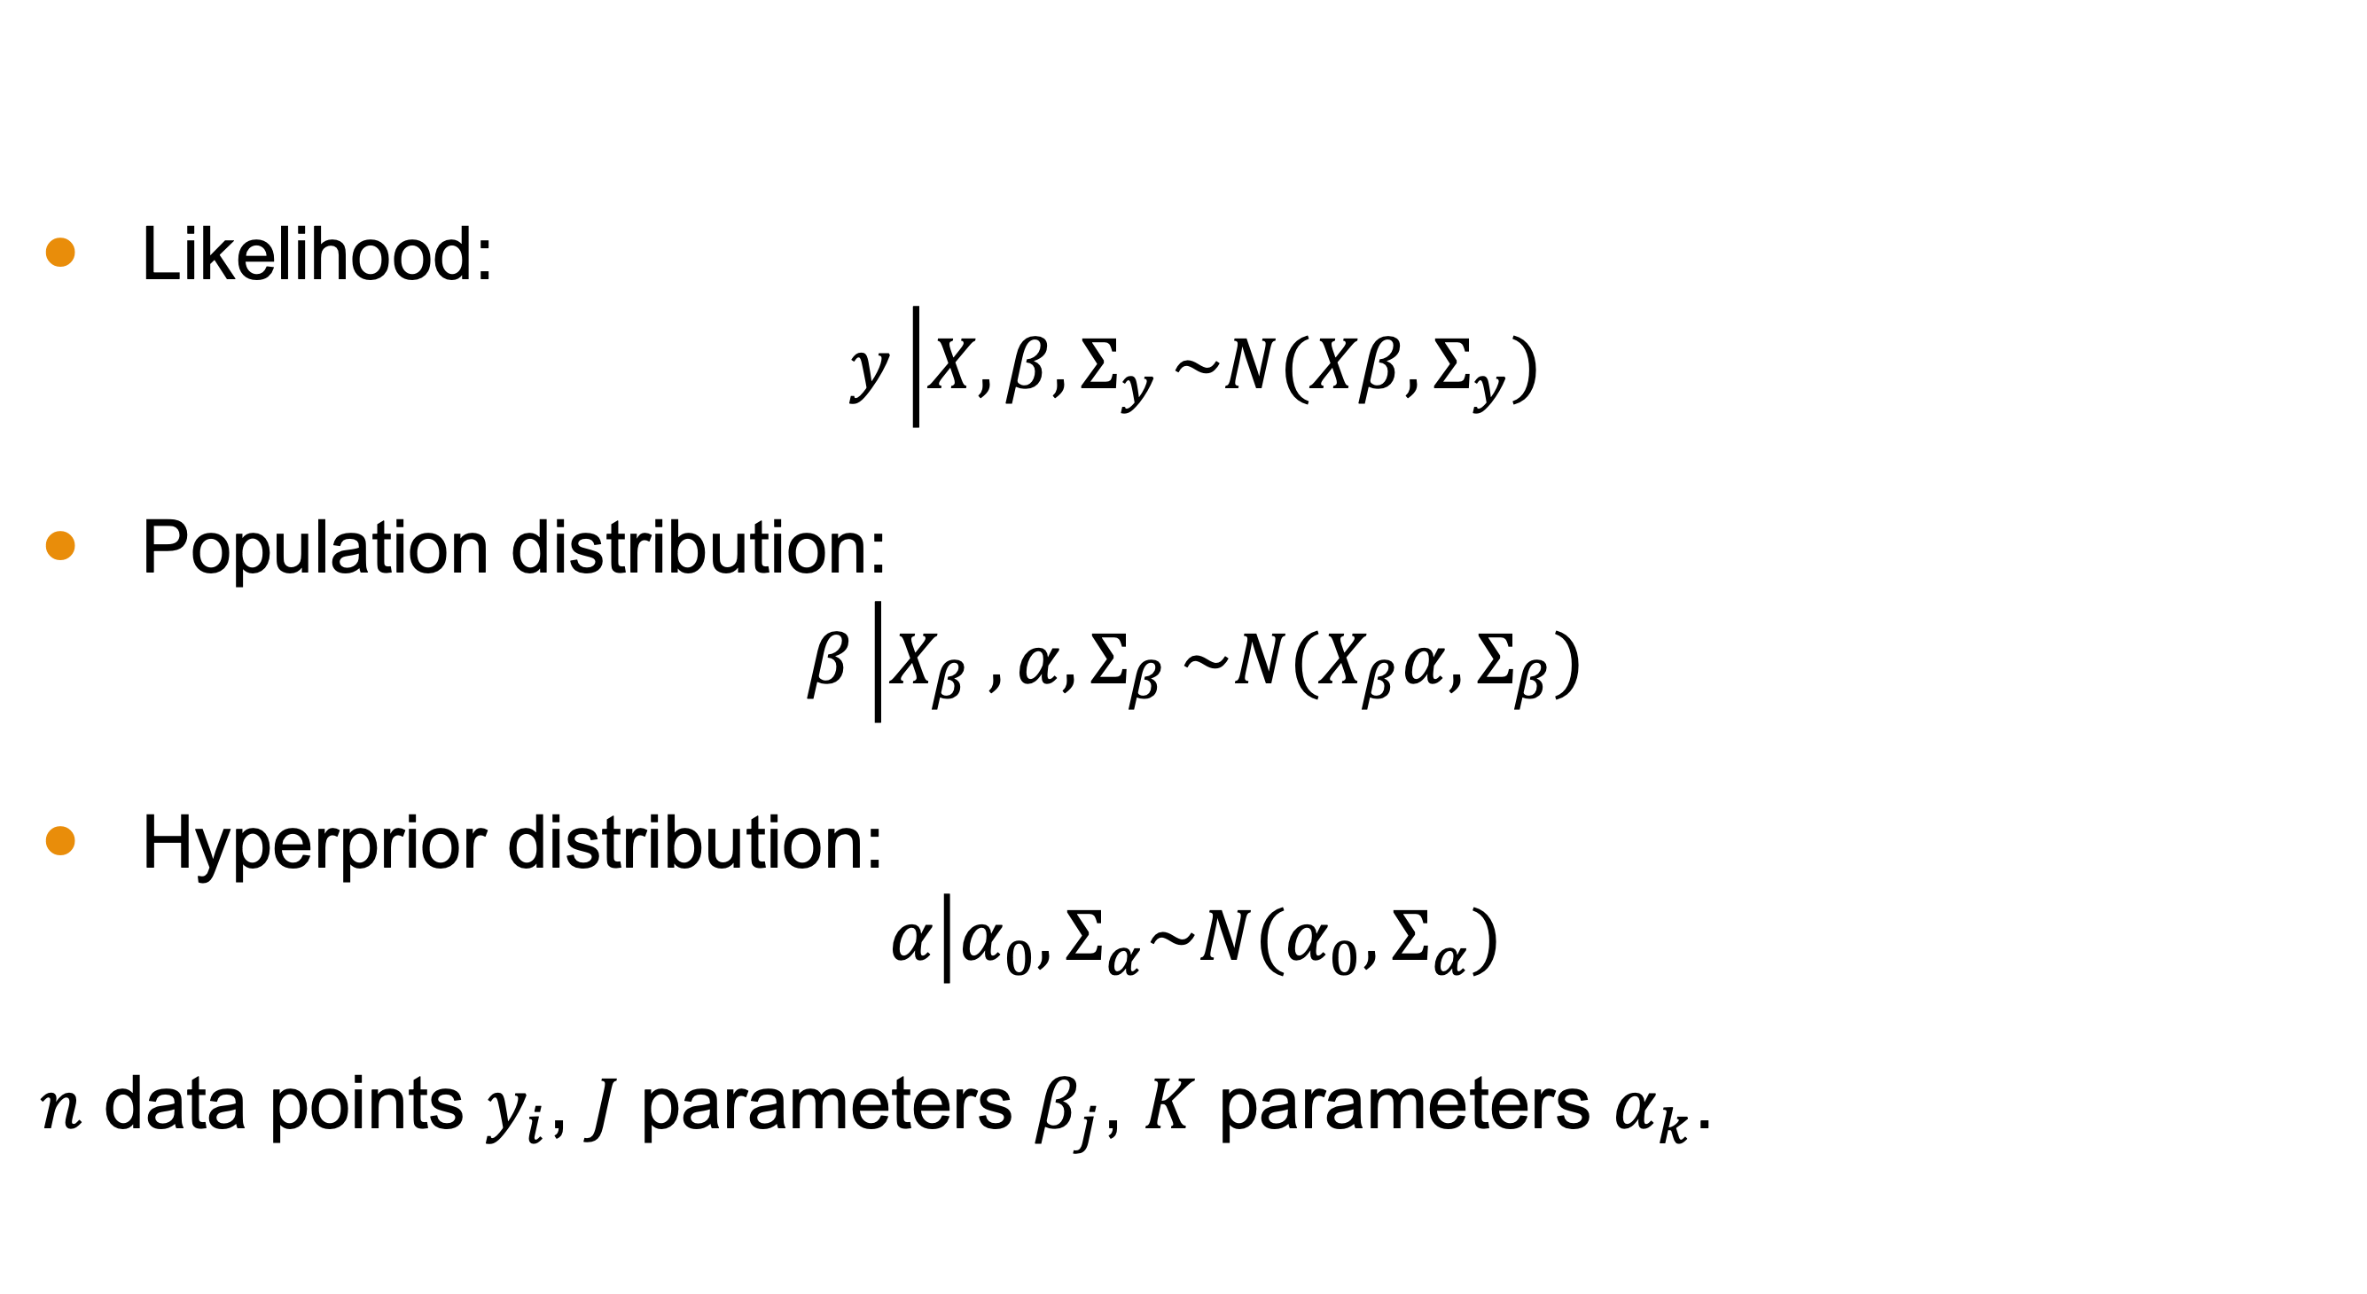
General Three-Level Model
Likelihood:
$$y\left|X,β,Σ_{y}\right.\sim N(Xβ,Σ_{y})$$
Population distribution:
$$β\left|X_{β} ,α,Σ_{β}\right.\sim N(X_{β}α,Σ_{β})$$
Hyperprior distribution:
$$α\left|α_{0},Σ_{α}\right.\sim N(α_{0},Σ_{α})$$
$n$ data points $y_{i}$, $J$ parameters $β_{j}$, $K$ parameters $α_{k}$.

Slide 28
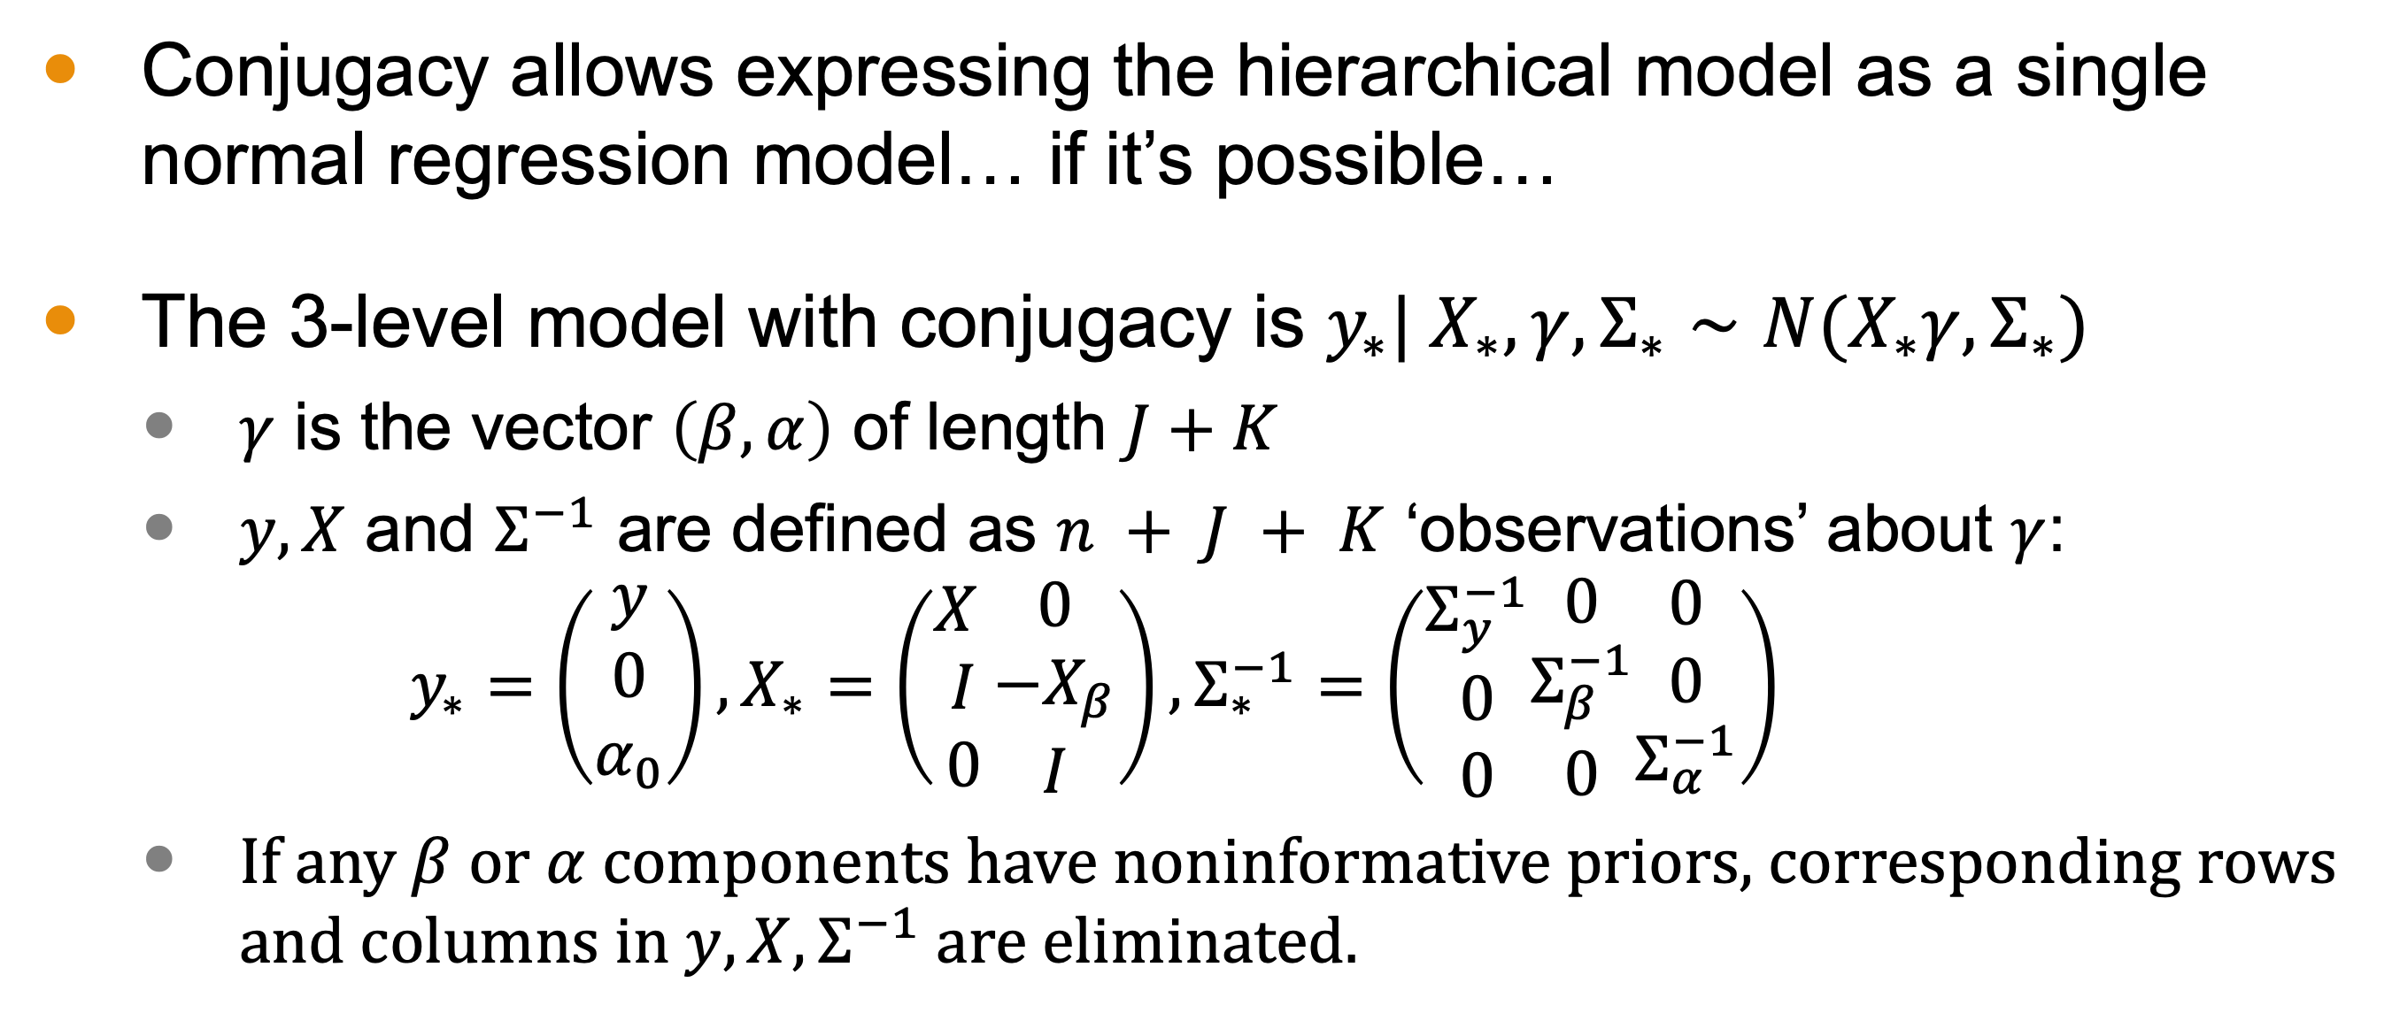
Interpretation as a Single Linear Regression
Conjugacy allows expressing the hierarchical model as a single normal regression model… if it’s possible…
The 3-level model with conjugacy is $y_{∗}| X_{∗},γ,Σ_{∗}∼N(X_{∗}γ, Σ_{∗})$
$γ$ is the vector $\left(β,α\right)$ of length $J+K$
$y,X$ and $Σ^{−1}$ are defined as $n + J + K$ ‘observations’ about $γ$: $y_{∗}=\left(\begin{aligned}y \\ 0 \\ α_{0}\end{aligned}\right),X_{∗}=\left(\begin{aligned}X& & \\ I \\ 0\end{aligned}\begin{matrix}0 \\ −X_{β} \\ I\end{matrix}\right), Σ_{∗}^{−1}=\left(\begin{aligned}Σ_{y}^{−1} \\ 0 \\ 0\end{aligned}\begin{matrix}0 \\ Σ_{β}^{−1} \\ 0\end{matrix}\begin{matrix}0 \\ 0 \\ Σ_{α}^{−1}\end{matrix}\right)$
If any $β$ or $α$ components have noninformative priors, corresponding rows and columns in $y, X, Σ^{−1}$ are eliminated.
Notes:
$y,X$ and $Σ^{−1}$ are defined considering likelihood, population, and hyperprior distributions as $n + J + K$ ‘observations’ informative about $γ$:

Slide 29
Next Time
Generalized Linear Models

